Slide 1
THE ORPHIC GARDENER
.

Slide 2
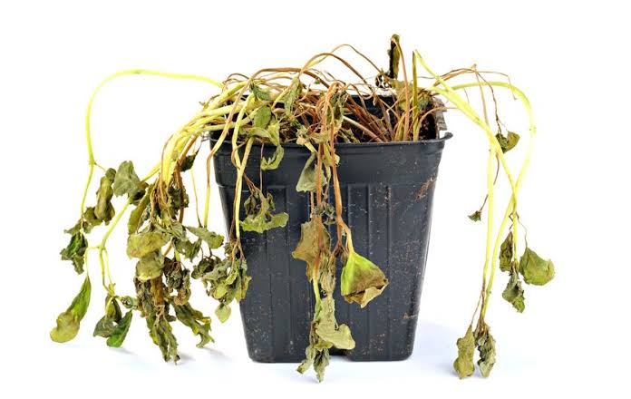
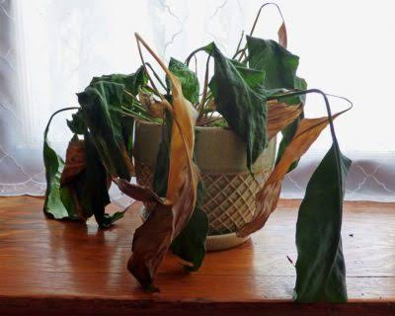
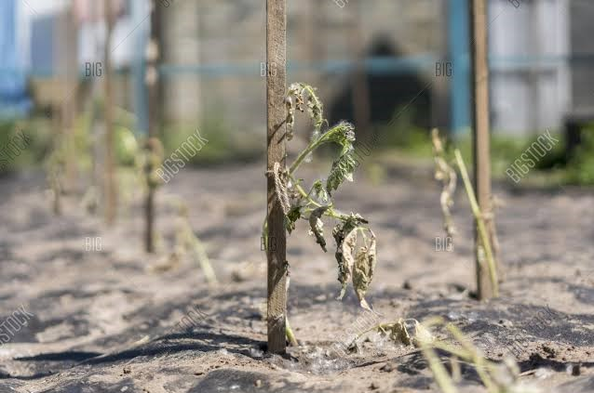
Why we came up with this idea ?
A lot many plants are planted by the government through plantation drive but only 50-60% survive rest gets dry up.
Main reason is lack of regularly watering…

Slide 3
Our gardener capabilities:
Check the soil moisture and turn on the water pump automatically ,whenever the moisture decreases.
Check the light intensity and provide artificial light if intensify decreases.
Check humidity of the surrounding and displays it
Play soothing music for the growth of the plants(tentative idea)

Slide 4
Uses:
No more need to worry for your plants, our gardener takes care of them.
Our gardener is completely automated and there is no need for any human intervention.
Our gardener is very useful in farms, gardens, home etc.

Slide 5
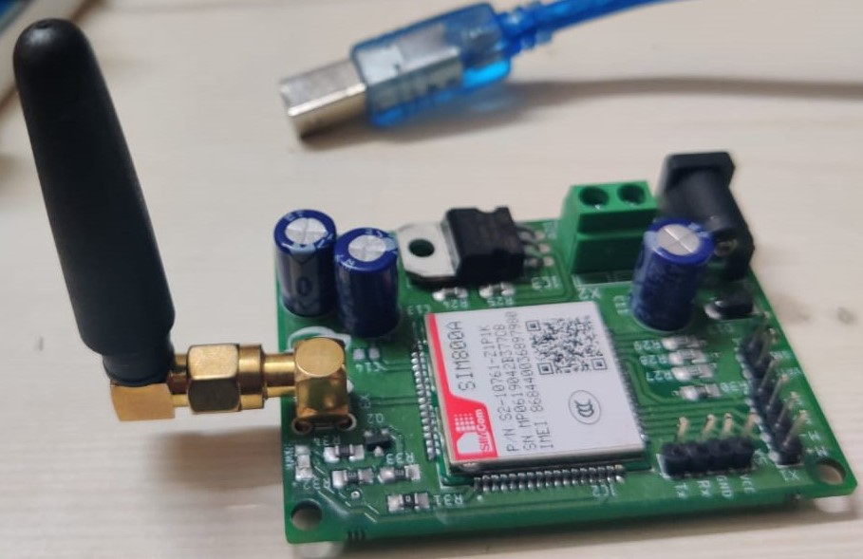
Failure along the path:
Earlier, we thought to send regular update to the owner’s phone number using GSM module. But unfortunately, our GSM module didn’t work, so we have to show every update on the LCD itself.
We also thought to play music for plants for soothing effect but, we lack the part to connect Arduino with speaker so, we aren’t able to add that feature.

Slide 6
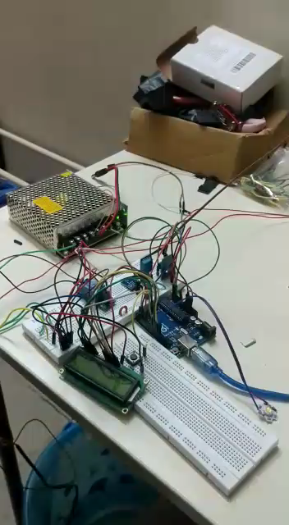
Our project

Slide 7
Gardener’s extension:
For using it in home, GSM module and soothing music for plants can be added to keep the owner updated and provide good vibrations to plants as well as people around them.
We can add security system, using ultrasonic sensor and if something comes birds or anything then a arm like stick moves and tries the protect the plant if the threat remain for a longer time then it will send alert the owner.
To use in a farm, it can be made movable so that it covers every area of the field and maintain the moisture level. We can also add a cutter to it, to use it in our gardens.

Slide 8
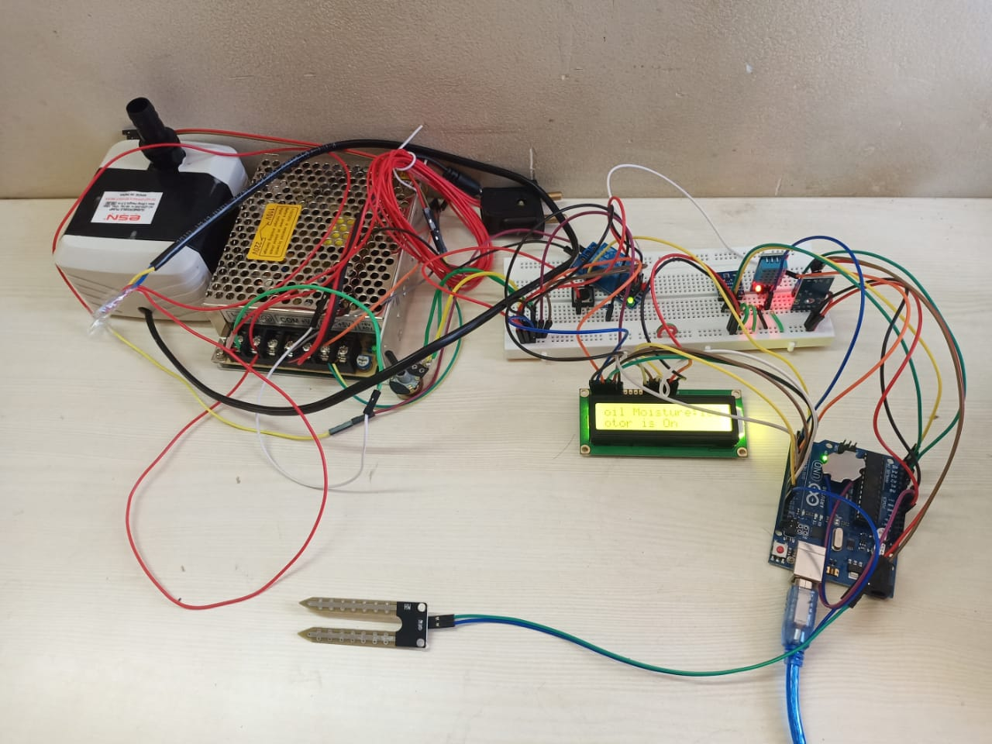
The art
The artists:
Brijesh Aghav
Shubam Agarwal
Jai Goyal
Akhilesh Dixit
Shreya Khadkekar
Ronak Devda

Slide 9
Thank you

